Slide 1
Enhanced Security Administrative Forest Section 1 – Dedicated Administrative Forest

Slide 2
Agenda
01
Active Directory Trust In this part we are digging deeper in the type of trusts.
02
Trust security considerations Let’s see how a trust can really hurt you.
03
Dedicated administrative forest And let’s see how trust can also dramatically improve your security posture!

Slide 3
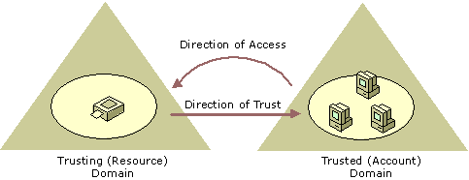
Active Directory trusts
Trusts extend the authentication and access of resources between users and computers from another domain or forest
Trusts have directions, if A trusts B, then users from B can access resources from A
The reciprocal rule is true when trusts are bi-directional
Notes:
A trust is a relationship, which you establish between domains, that makes it possible for users in one domain to be authenticated by a domain controller in the other domain.

Slide 4
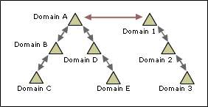
Trust types and transitivity
Trust type | Transitivity | Direction
External | Nontransitive | One-way or two-way
Realm | Transitive or nontransitive | One-way or two-way
Forest | Transitive | One-way or two-way
Shortcut | Transitive | One-way or two-way
All domains in the Domain A tree and all domains in the Domain 1 tree have transitive trust relationships by default. As a result, users in the Domain A tree can access resources in domains in the Domain 1 tree, and users in the Domain 1 tree can access resources in the Domain A tree when the proper permissions are assigned at the resource.
Notes:
External
Use external trusts to provide access to resources that are located on a Windows NT 4.0 domain or a domain that is located in a separate forest that is not joined by a forest trust.
Realm
Use realm trusts to form a trust relationship between a non-Windows Kerberos realm and a Windows Server 2008 domain.
Forest
Use forest trusts to share resources between forests. If a forest trust is a two-way trust, authentication requests that are made in either forest can reach the other forest.
Shortcut
Use shortcut trusts to improve user logon times between two domains within a Windows Server 2008 forest. This is useful when two domains are separated by two domain trees.
Transitivity
Shortcut trust: A transitive trust between a domain in the same domain tree or forest that shortens the trust path in a large and complex domain tree or forest.
Forest trust: A transitive trust between a forest root domain and a second forest root domain.
Realm trust: A transitive trust between an Active Directory domain and a Kerberos V5 realm.

Slide 5
TDO
Trust Domain Object
To enable cross-domain authentication, protocols have to figure out how to encrypt things between domains
NTLM is using a secure channel
Kerberos is using referral tickets
But what key should we use to encrypt the channel or the tickets?
When you create a trust, it creates an object in AD that looks like a user but isn’t and it’s called a Trust Domain Object
Those TDOs update their password every 30 days
The password of the TDOs are the trusted domain’s secret

Slide 6
Cross domain authentication (NTLM)
fabrikam.com
contoso.com
contoso
fabrikam
fabrikam
DC1
secure channel
DC2
FILE1
FABRIKAM\Bob
= TDO
Notes:
The secure channel between DC2 and DC1 is encrypted based on the secret of the TDO for fabrikam in the contoso.com domain.

Slide 7
Cross domain authentication (Kerberos)
fabrikam.com
contoso.com
contoso
fabrikam
DC1
DC2
contoso
TGS referral
FILE1
FABRIKAM\Bob
= TDO
Notes:
When Kerberos is used, Bob would need a service ticket from the DC of contoso to access FILE1. To obtain a ticket, Bob needs to get a TGT before. But it cannot get a TGT for contoso because it has no accounts in this realm.
So when Bob is asking a ticket for the SPN CIFS/FILE1.CONTOSO.COM, DC1 returns a referral ticket which is using the derived secret from the contoso TDO’s long term key to encrypt the ticket. When DC2 receives the referral ticket, it can decrypt it because it has a knowledge of the TDO’s key as well.

Slide 8
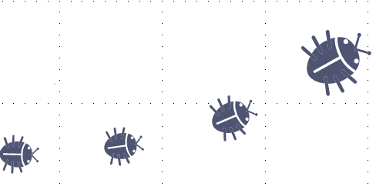
Security Considerations
You seem like a trustworthy person!
I sure am! Let’s create a trust!
Notes:
Although it might sound like a truism, if you want to build an AD trust, you need to “trust” your partner. And to trust it, you need to know what security practices they have.
Forests are security boundaries, users in the other forest will have different authentication methods, different password policies, different approaches when it comes to threat management. All of these have to be considered when creating an AD trust.
Security principals from a trusted forest should not be given privileges on the trusting forest as the trusting forest does not control the accounts’ authentication nor policies.
In the next slides, we will have a look at the technical security considerations to have when building and managing trust relationships.

Slide 9
sIDHistory
If trusts are created with the intent of migrating objects from one domain to another, the sIDHistory attribute will guarantee that users keep their access during the process
For a user, a new domain = a new SID
ACEs are referencing SIDs, if you change your SID you loose your access
The sIDHistory attribute will contain the previous objectSID of a security principal once it has moved to a new domain
When the migration is over, ACEs have to be updated with the new SIDs and the sIDHistory attributes must be deleted
Notes:
Tools such as the Active Directory Migration Tool (ADMT) can be used to migrate users, groups and machines once a trust has been established.
Ref: https://www.microsoft.com/en-us/download/details.aspx?id=19188
Note that in reality, sIDHistory rarely gets deleted because migrations are rarely executed until the end.

Slide 10
Abuse of the sIDHistory
sIDHistory can be leveraged by a rogue admin from a trusted domain to add SIDs from privileged accounts of the trusting domain
If the sIDHistory is not required for a migration perspective, then its usage should be prohibited over the trust
External trust: enable quarantine
Forest trust: disable sIDhistory
Notes:
Other methods to abuse sIDHistory according to: https://technet.microsoft.com/pt-pt/library/cc755321(v=ws.10).aspx
Disk Editors
A disk editor, such as the DiskProbe utility included in the Windows Server 2003 support tools, could also be used to mount an attack. A malicious user could boot into another operating system and use a disk editor to modify an offline Active Directory database. With a disk editor, the user could modify the SID history attribute, modify replication attributes so the change would be replicated, and calculate a new directory checksum so as to prevent Active Directory from detecting that the directory was improperly modified. This attack is difficult not only because it requires physical access to a domain controller, but all of the tasks are technically complex.
Debuggers
Debuggers can also be used maliciously. A user could attach a debugger to a domain controller and use it to modify the copy of the directory loaded in memory. This method is also technically sophisticated. It requires the attacker to have unrestricted physical access, be a domain administrator, and be able to use system APIs to modify system-level code that is not publicly available.
Command line to enable/disable quarantine:
netdom trust TrustingDomainName /domain:TrustedDomainName /quarantine:Yes /usero:domainadministratorAcct /password*
Command line to enable/disable sidHistory over forest trust:
netdom trust TrustingDomainName /domain:TrustedDomainName /enablesidhistory:No /usero:domainadministratorAcct /passwordo:*
Ref: https://docs.microsoft.com/en-us/previous-versions/windows/it-pro/windows-server-2003/cc755321(v=ws.10)

Slide 11
Other TDOs’ security options
Disable Kerberos unconstrained delegation over trust
This prevents services in the other forests from receiving forwarded TGTs
Enable selective authentication
By default, trusted accounts can potentially request access to all resources of the trusting domain
This can be changed, and resources have to be explicitly authorized to request access to resources in the trusting domain
Notes:
Starting Windows Server 2016, it is possible to restrict the use of Kerberos delegation over trust. It is now possible to block unconstrained delegation.
You need to use the netdom.exe utility to enable/disable it. By setting /EnableTgtDelegation to no, services in the other forests with "Trust this computer/user for delegation to any service“ configured will not be able to use Kerberos full delegation with any account in this forest to any service.

Slide 12
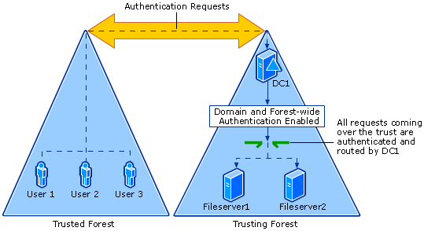
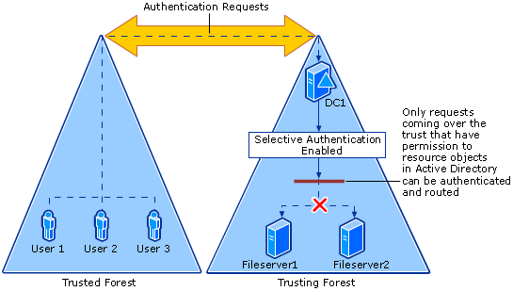
Selective authentication
Before…
Before …
Notes:
When selective authentication is enabled, all authentication requests made over a trust to the trusting forest are tagged with an identifier that subjects the request to closer scrutiny by the domain controllers in the domain where the target resource is located. This is important because the mere presence of this identifier triggers the domain controller in the resource domain to first check whether the user requesting the access has been given explicit permissions to the Active Directory object where the resource is hosted. The appropriate permission to the resource object in Active Directory is verified before the domain controller sends a service ticket back to the requesting workstation in the trusted forest.

Slide 13
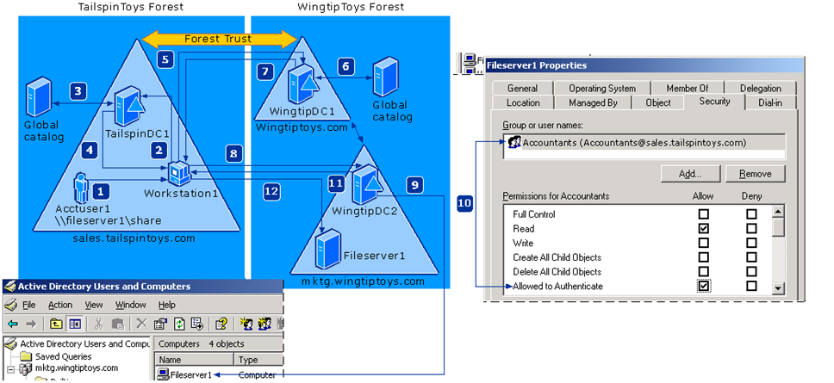
Selective authentication (authentication flow)
Notes:
Fom: https://docs.microsoft.com/en-us/previous-versions/windows/it-pro/windows-server-2003/cc755321(v=ws.10)#w2k3tr_trust_security_zyzk
This illustration incorporates images from Active Directory Users and Computers in the Microsoft Management Console to help you better understand at what point during the authentication process a domain controller queries the Allowed to Authenticate permission for the resource object.
Acctuser1 logs on to Workstation1 using credentials from the Sales.tailspintoys.com domain. The user then attempts to access a shared resource on FileServer1 located in the WingtipToys forest. Acctuser1 is also a member of the Accounting global group in the Sales.tailspintoys.com domain.
Workstation1 contacts the Key Distribution Center (KDC) on a domain controller in its domain (TailspinDC1) and requests a service ticket for the FileServer1 SPN. FileServer1 is located in the Mktg.wingtiptoys.com domain and is a member server.
TailspinDC1 does not find the SPN in its domain database and queries the global catalog to see if any domains in the TailspinToys forest contain this SPN. Because a global catalog is limited to its own forest, the SPN is not found. The global catalog then checks its database for information about any forest trusts that are established with its forest, and, if any are found, it compares the name suffixes listed in the forest trust trusted domain object (TDO) to the suffix of the target SPN to find a match. Once a match is found, the global catalog provides a routing hint back to TailspinDC1.
Using the information in the routing hint, TailspinDC1 sends a referral for a domain controller located in the forest root domain of the WingtipToys forest back to Workstation1.
Workstation1 contacts a domain controller in the forest root domain (WingtipDC1) of the Corp.wingtiptoys.com forest and requests a service ticket to the Fileserver1 resource computer.
WingtipDC1 contacts its global catalog to find the SPN, and the global catalog finds a match for the SPN and sends it back to WingtipDC1.
Because the authentication request originated from the TailspinToys forest and selective authentication is enabled WingtipDC1 applies the Other Organization SID to the user’s authorization data and then sends a referral for the mktg.wingtiptoys.com domain back to Workstation1.
Workstation1 contacts the KDC on WingtipDC2 and attempts to negotiate a ticket for Acctuser1 to gain access to FileServer1.
WingtipDC2 detects the Other Organization SID in the authorization data of Acctuser1, which requires the domain controller to first locate the computer object of the resource computer (Fileserver1) before providing a ticket back to the requesting computer.
Once the computer object is located, the domain controller must check whether the user requesting access to the resource computer has been explicitly granted the Allowed to Authenticate permission on the Fileserver1 computer object located in the Mktg.wingtiptoys.com domain. This process must complete successfully before WingtipDC1 can provide a ticket back to the requesting computer.
Note
In this example, Acctuser1 is a member of the Accounting group in the TailspinToys forest and that group has been explicitly granted the Allowed to Authenticate permission to this computer object residing in Active Directory.
After WingtipDC1 determines that Acctuser1 has the required permission to Filerserver1, it sends a service ticket back to Workstation1 permitting it to gain access to FileServer1.
Now that Workstation1 has a service ticket, it sends the server service ticket to FileServer1, which reads the security credentials for Acctuser1 and constructs an access token accordingly.

Slide 14
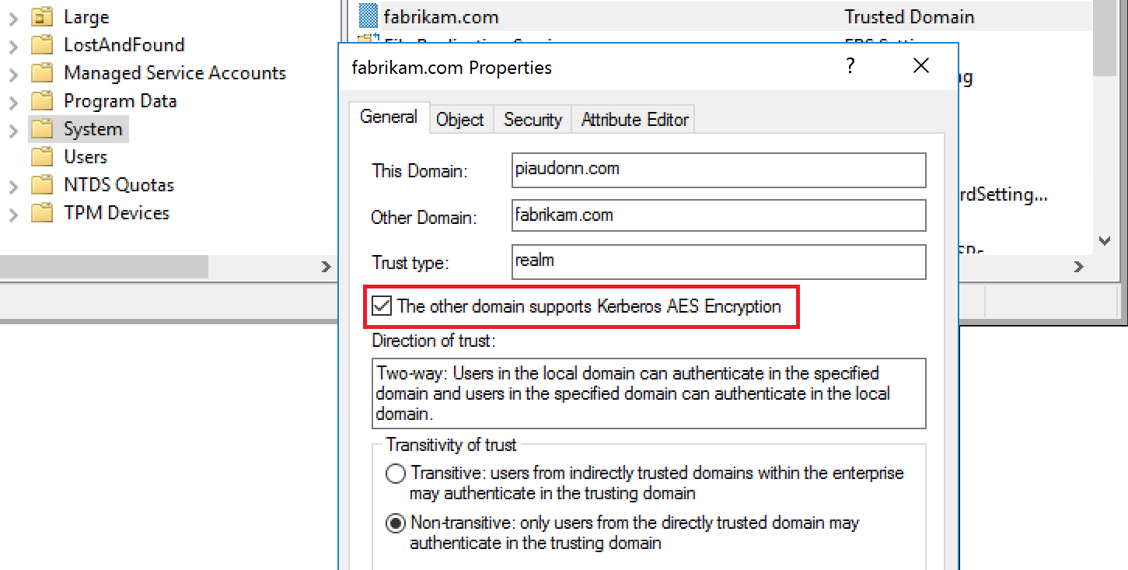
Professor Useful
You can also use Kerberos AES encryption over trusts
Make sure your domain knows about it
You can do it from the DSA.MSC console
Notes:
Note that you can do it with the Domains and Trusts console. Open the Active Directory Domains and Trusts Microsoft Management console (MMC) snap-in on a domain controller that is in the parent domain:
Right-click the domain name of this parent domain to open the Properties dialog box.
On the Trusts tab, select the trust between the parent domain and the child domain, and then click Properties.
Click to select or clear The other domain supports Kerberos AES Encryption option check box.
Click OK, and then restart the domain controllers that are in both domains to apply the setting.
Ref: https://support.microsoft.com/en-us/help/975616/

Slide 15
How many admins do you have?
Virtually, zero is the right number!
Create a new forest
Create a one way trust
The production forest trusts the new forest
The users from the new forest can access the production
The production’s users cannot access the new forest
Move your admins from the production to the new forest!
Notes:
These are a basic concepts of a dedicated admin forest.
“move” implies that you should not have admin accounts anymore in production and instead create the accounts in the new forest (the dedicated admin forest).
You need to make sure the production no longer has admin accounts (hence no credential theft with privileged accounts anymore since there are none).
You can also have multiple one-way trusts with the same administrative forest. Let’s say you currently have several forests in production, you probably have more than one admin account per IT staff in charge of the administration (possibly one per forest). By creating a dedicated admin forest, you can reduce the overall number of admin accounts by making sure there is just one instance of them, in the administration forest.

Slide 16
Dedicated Administrative Forest
0 admins in production = 0 accounts to steal
Admin accounts are in the dedicated forest
The dedicated forest is hardened big time
Nothing to worry about LOB applications not being compatible, this is just for admins
You can enable all fancy protections
Separate infrastructure
If DCs are VMs, they should be shielded-VMs
Does not share SCCM/SCOM (or other agent-based solutions) from the production
Separate administrative machines (see next section)
Enable selective authentication
Restrict accounts in the admin forest to only access the appropriate production hosts
Notes:
A dedicated administrative forest is a standard single domain Active Directory forest dedicated to the function of Active Directory management. Administrative forests and domains may be hardened more stringently than production forests because you do not have to worry about compatibility with the production workloads.
The value of an admin forest is the high level of security assurance and reduced attack surface resulting in lower residual risk. The forest can be used to house additional management functions and applications, but each increase in scope will increase the attack surface of the forest and its resources. The objective is to limit the functions of the forest and admin users inside to keep the attack surface minimal, so each scope increase should be considered carefully.
Although building an additional forest might sound like an administrative overhead, it makes it easier to manage privileged accounts as they will be existing only in one place with no way for the production environment (or environments) to get to it.
Some protections are hard to implement in a mix production/administration environment (a traditional forest) because they might impact production applications. Hardening such as:
Enforcing LDAP signing
Blocking NTLM
Forcing AES tickets (Preventing Kerberos change password that uses RC4 secret keys https://docs.microsoft.com/en-us/windows-server/security/kerberos/preventing-kerberos-change-password-that-uses-rc4-secret-keys)
Can be deployed without impacting regular users.

Slide 17
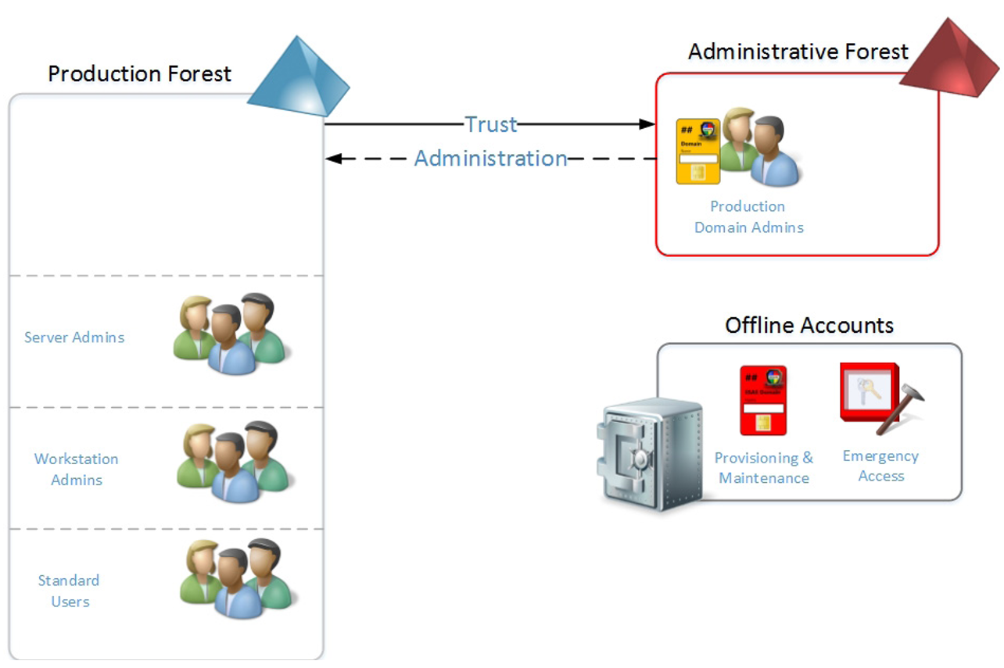
Dedicated Administrative Forest
Notes:
The accounts in the administrative forest can be members of the built-in administrative groups in the production forest.
Those accounts do not need to be administrators of the administrative forest.
The privileged accounts should be used only from dedicated systems (also called Privileged Administrative Workstations). This will be covered in the next section.

Slide 18
PIM Forest Trust
A new forest trust type
Which allows shadow principals
Microsoft Identity Manager 2016 SP1
On-premises identity and access management product
Provides Just-in-Time administrative privileges
Provides an auditable, enforced, and time-limited access to critical assets
MIM has an embedded SharePoint to handle accounts requests
How do users request privileged access?
PowerShell, REST API or the MIM Services Web Services (via a web portal)
MIM
JiT
Notes:
Microsoft Identity Manager 2016 is not free. Therefore the cost of the license also has to be taken into consideration when opting for this solution.
KDC enhancements are built in to Active Directory domain controllers to restrict Kerberos ticket lifetime to the lowest possible time-to-live (TTL) value in cases where a user has multiple time-bound memberships in administrative groups. For example, if you are added to a time-bound group A, then when you log on, the Kerberos ticket-granting ticket (TGT) lifetime is equal to the time you have remaining in group A. If you are also a member of another time-bound group B, which has a lower TTL than group A, then the TGT lifetime is equal to the time you have remaining in group B.
Ref: https://docs.microsoft.com/en-us/microsoft-identity-manager/pam/privileged-identity-management-for-active-directory-domain-services
Remember that you cannot add users from an external forest into the Domain Admins or Enterprise Admins groups. However, you can add a user from the dedicated administrative forest into the built-in Administrators group of the production environment. Thanks to Shadow principal, you can add administrators from the administrative forest into the shadow principal of a production group and have the SID of that group when connecting to the production forest

Slide 19
Shadow principals
A new security principal
It has the objectSID of selected production security principal
If a user is a part of a shadow principal, the SID of the object is in the Kerberos PAC of the ticket when accessing the production forest
Notes:
Remember that you cannot add users from an external forest into the Domain Admins or Enterprise Admins groups. However, you can add a user from the dedicated administrative forest into the built-in Administrators group of the production environment. Thanks to Shadow principal, you can add administrators from the administrative forest into the shadow principal of a production group and have the SID of that group when connecting to the production forest.
Ref: https://msdn.microsoft.com/en-us/library/mt220492.aspx

Slide 20

Credentials partitioning
Tier-0
Security Dependencies
AD Service
AD Service &
Dependencies
Global Access Control
Tier-1
AD Data
Business Enablement
Enterprise Data & Services
Privileged Account
Tier-2
Devices and Users
Standard User Activity
Regular day-to-day user activities
Productivity Account
Notes:
A persona would have 2 accounts. Its normal account for regular activity, and its privileged account which is in the PAM forest.

Slide 21
Time-limited group membership
Users can be added to a security group with time-to-live (TTL)
When the TTL expires, the user’s membership in that group disappears
Kerberos token lifetime will be determined by TTL of the user’s memberships
TGT based on shortest group membership
Requires new FFL
Windows Server 2016 FFL
Member: <TTL,user-DN>
Group
User
TGT: Shortest group
lifetime
ST: Shortest of TGT and resource local domain group
Notes:
Scavenger thread takes care of cleaning up group memberships.
Note that you can also use time-limited group membership without a PIM trust (although you need to enable the PIM trust support). You can simply use them in a mono-forest without an administrative forest.
Example using PowerShell:
Enable-ADOptionalFeature ‘Privileged Access Management Feature’ -Scope ForestOrConfigurationSet -Target contoso.com
Now that you’ve done this, you can start setting time limits on group memberships directly. It’s so easy: Add-ADGroupMember -Identity ‘Domain Admins’ -Members ‘Bob’ -MemberTimeToLive (New-TimeSpan -Hours 5)
(Get-ADGroup ‘Domain Admins’ -Property member -ShowMemberTimeToLive).Member
<TTL=17952>,CN=Bob,OU=Accounts,DC=contoso,DC=com
…

Slide 22
Shadow principals
New shadow security principals (groups) that are provisioned in the bastion forest by MIM in response to administrative privilege requests
The SID of the shadow principal is the SID of a production group
The SID of the shadow principal is added to the Kerberos ticket when connecting to production resources
Notes:
The shadow security principals have an attribute that references the SID of an administrative group in an existing forest. This allows the shadow group to access resources in an existing forest without changing any access control lists (ACLs).

Slide 23
Quick summary
A dedicated administrative forest is a good way to isolate the privileged accounts and harden the domain to a higher level than production
Just a one-way trust with selective authentication
You can push the concept further if the resources are available and deploy a PIM forest
Using MIM 2016
Notes:
These are possibilities, they are not hard requirements. Consider the pros and cons of each option to ensure it suits the customer’s resources and environment.

Slide 25
List of abbreviations
TDO Trust Domain Object
PIM Privilege Identity Management
MIM Microsoft Identity Manager
JiT Just-in-Time

